Slide 1
TANK WATER LEVEL AND QUALITY MONITORING
PRESENTED By :
BHARANI.S(22AI004),
BHARANIDHARAN.G(22AI005),
KEERTHIVARSAN.D(22AI022).
Guided By :
Dr.K.Lalitha
TEAM NO. 4
22AIC14 & INTERNET OF THINGS AND ITS APPLICATIONS

Slide 2
Abstract
This project presents an IoT-based system for monitoring both the water level and quality in tanks. It uses sensors to measure the water level and assess parameters like pH, temperature, and turbidity to ensure water quality.
The data is transmitted in real-time to users via a mobile app or web interface, alerting them to critical changes in water levels or quality. This system offers a cost-effective solution for efficient water management in residential, agricultural, and industrial settings.

Slide 3
Objectives:
The objective of this project is to develop an automated system for real-time monitoring of tank water levels and quality using IoT-based sensors.
The system aims to provide timely alerts for critical changes, ensuring efficient water management and the maintenance of safe, usable water for residential, agricultural, and industrial purposes.

Slide 4
Components Required:
Ultrasonic Sensor (HC-SR04): For water level detection.
pH Sensor: To measure the acidity/alkalinity of the water.
Turbidity Sensor: To measure water clarity.
Temperature Sensor (DS18B20): To monitor the water temperature.
TDS Sensor: To measure Total Dissolved Solids (water purity).
Microcontroller: Arduino Uno or Raspberry Pi to interface with sensors and process data.
Wi-Fi Module (e.g., ESP8266): For IoT functionality (sending data to the cloud).
Power Supply: For powering the components.
Cloud Service (optional): For remote monitoring (e.g., Firebase, Thingspeak).

Slide 5
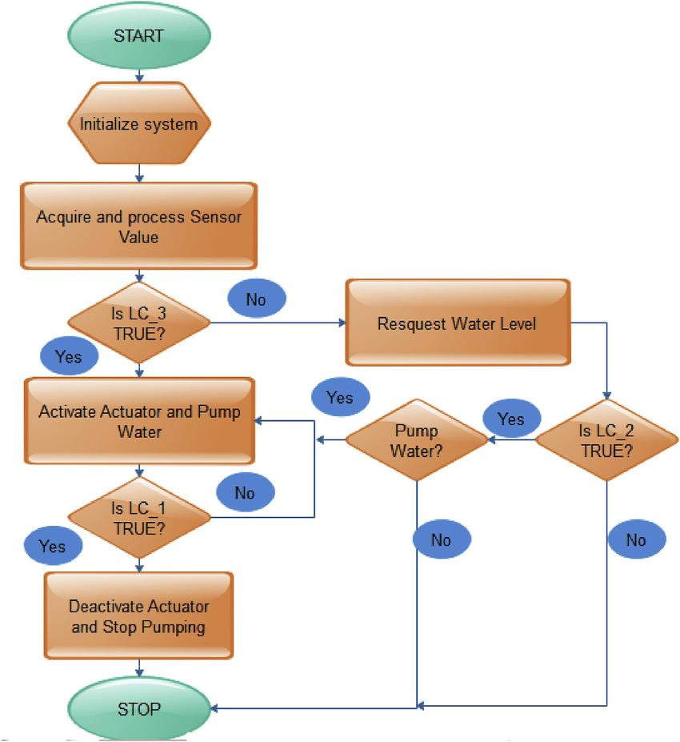
Flow Diagram:

Slide 6
Implementation: (Hardware)
Install Sensors: Place hydrostatic sensors at the bottom of the tank and quality sensors at strategic points to monitor various parameters.
Connect to Microcontroller: Wire the sensors to the microcontroller, ensuring proper configuration for data reading.
Set Up Connectivity: Configure the microcontroller to connect to the internet via Wi-Fi or LoRaWAN.
Develop User Interface: Create a mobile app or web dashboard to display real-time data and alerts.
Testing and Calibration: Test the system for accuracy and calibrate sensors as necessary.

Slide 7
Thank You

